Slide 1
Introduction to Data Visualization & Visual Perception
Created By: Jeffrey A. Shaffer Vice President, Unifund Adjunct Faculty, University of Cincinnati (513) 615-0001 | JeffreyShaffer@gmail.com @HighVizAbility
Notes:
Title Slide

Slide 2
Table of Contents/Agenda
What is Data Visualization
History of Data Visualization
Visual Perception
The Building Blocks of Data Visualization
Slide 3
Slide 27
Slide 41
Slide 79
Notes:
NOTE:
This slide can be deleted and the sections can be split up or ordered differently if needed.

Slide 3
Goals
By completing the course modules, students will:
Define data visualization and express its value as a tool for understanding our world
Describe the fundamental aspects visual perception and these relate to data visualization
Learn the history of data visualization, important people in the field, and contemporary practitioners
Understand the preattentive attributes, the embedded meaning of color and size, and the two thinking systems that we use to process the world around us

Slide 4
What is Data Visualization? And Why is it Important?
Notes:
NOTE:
The purpose of this section is to understand what data visualization is and why it is important.

Slide 5
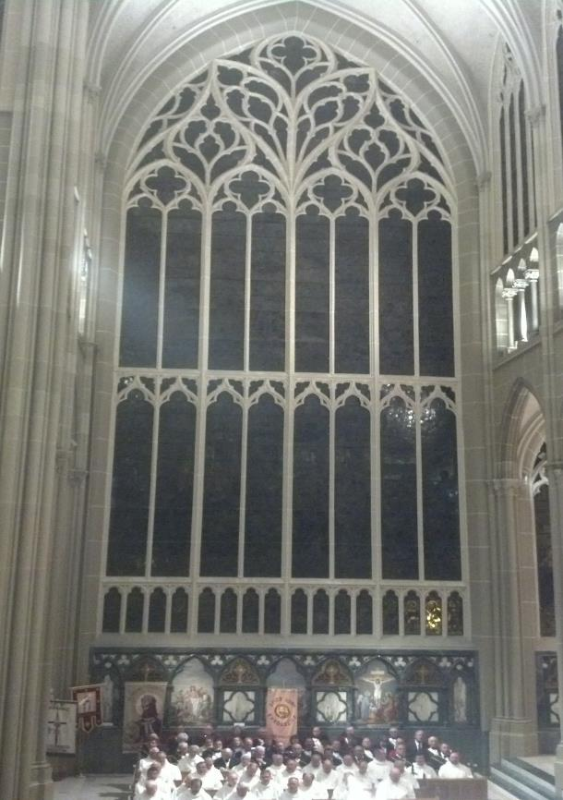

Notes:
“Does anyone know what this is?” “It’s a stained-glass window. It’s actually the largest stained-glass in the Western Hemisphere. It’s
in Covington, KY at the Cathedral Basilica. This is your data.” [Click the slide animation] “This is what we are trying to do with the data. We are trying to illuminate the data to gain insight.” {Click the Slide ] “And if we do it well, then we can sometimes tell a story in the data.”

Slide 6

Notes:
“Here we see Jeff Shaffer, the data visualization professor at the University of Cincinnati, playing a flugelhorn in front of that stained-glass window. We’re now telling a story with the data, far beyond what was being told from the ‘data’ in the window.”

Slide 7
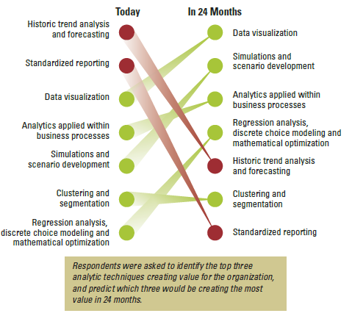
Analytics: A New Path to Value – MIT 2010
Source: Big Data, Analytics and the Path From Insights to Value
MIT Sloan Management Review, December 2010
Notes:
In 2010, MIT, in collaboration with IBM, survey 3,000 business executives, managers and analysts from organizations all over the world. They were asked “Where are data-driven managers headed?” As you can see, they predicted that in 2 years data visualization was going to be the analytical technique that creates the most valuable for an organization.

Slide 8
Visual analytics is a growing field…
“…2014 will be a critical year in which the task of making ‘hard types of analysis easy’ for an expanded set of users…will continue to dominate BI market requirements.” – Gartner 2014 Magic Quadrant for Business Intelligence and Analytics Platforms

Slide 9
Visual analytics is a growing field…
Data visualization classes now taught at universities
Has become part of Business Analytics, Statistics, Information Systems, Business Administration and Econometrics.
Companies adding visual analyst positions
Visually trained business analysts with a data orientation
Growing ranks of data “storytellers” and “data visualization” positions
Notes:
In 2010, “data visualization” was part of job specification. Companies were looking for various positions and in the job listing they would ask for “experience in visualizing data”. By 2015, there were job positions all over for “data visualization” where the entire job is focused around visualizing data. In 2017, Capital One hired Kim Reese from Periscopic as the “Head of Data Visualization”. This is a major credit card issuer who now has a “head of data visualization”.
[This is a good opportunity to search Indeed.com for “Data Visualization” and show the students how many positions are now out there in the field.]

Slide 10
Current Data Visualization Jobs (July 2017)
Data Visualization Designer/Storyteller at Facebook
Data Visualization Expert as a Leading Hedge Fund
Data Visualization Manager at Deloitte
Source: Indeed.com
Notes:
NOTE:
These can be updated with the most recent jobs by searching “Data Visualization” on Indeed.com

Slide 11

“In God we trust, all others bring data.” - W. Edwards Deming
Notes:
Deming said, ‘In God we trust, all others bring data.’ But what do we do with that data?

Slide 12
Business Intelligence
Moving from data to action….
_{Data}
_{Information}
_{Knowledge}
Plan to guide actions or key decisions
Notes:
This is a common theme in business intelligence. The idea of using data to create information. Information becomes knowledge and then ultimately strategy; plans that guide a company or strategic business unit (SBU).

Slide 13
_{Data}
Facts and statistics collected together for reference or analysis.
_{Information}
Facts provided or learned about something or someone.
_{Knowledge}
Information and skills acquired through experience or education; the theoretical or practical understanding of a subject.
_{Strategy}
A plan of action or policy designed to achieve a major or overall goal.

Slide 14
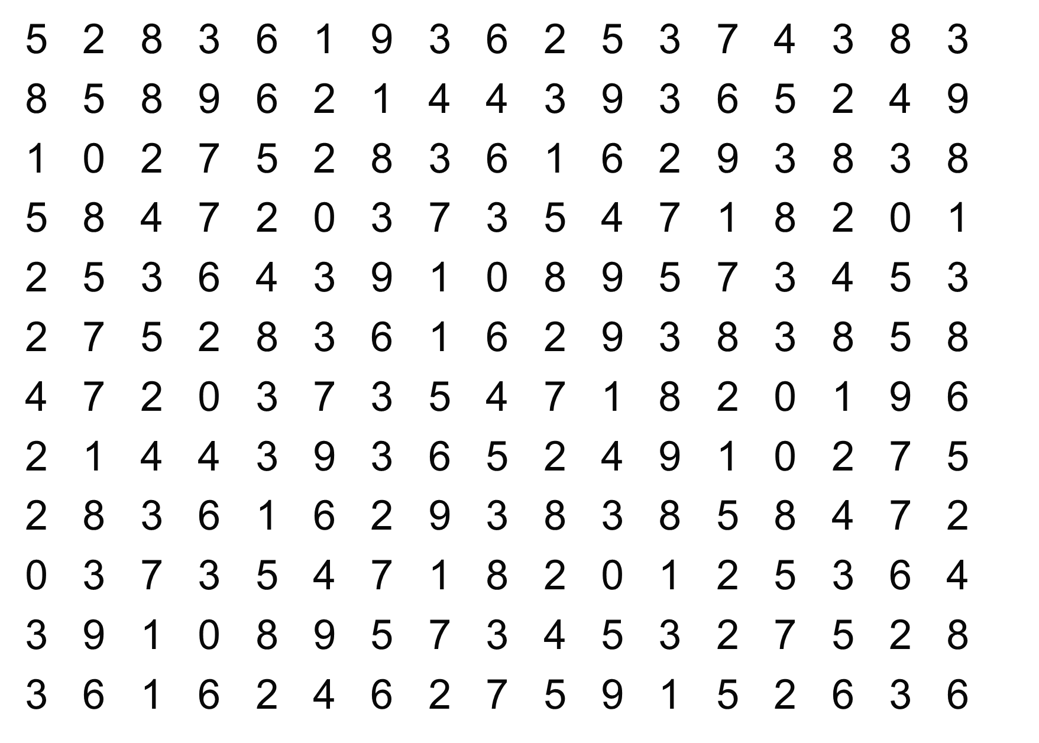
How many times does the digit 7 appear?
Notes:
Try to count the number of times the digit 7 appears in this data set. [give the students about 30 seconds to come up with a number, but don’t let them shout it out. After the exercise, as how many had 15, then 16, 17, 18, 19]. “Notice two things about this exercise. One, it takes a good bit of time to find them. Two, notice the error. Not everyone will come up with the same number.” [we will give the answer in a few slides]

Slide 15
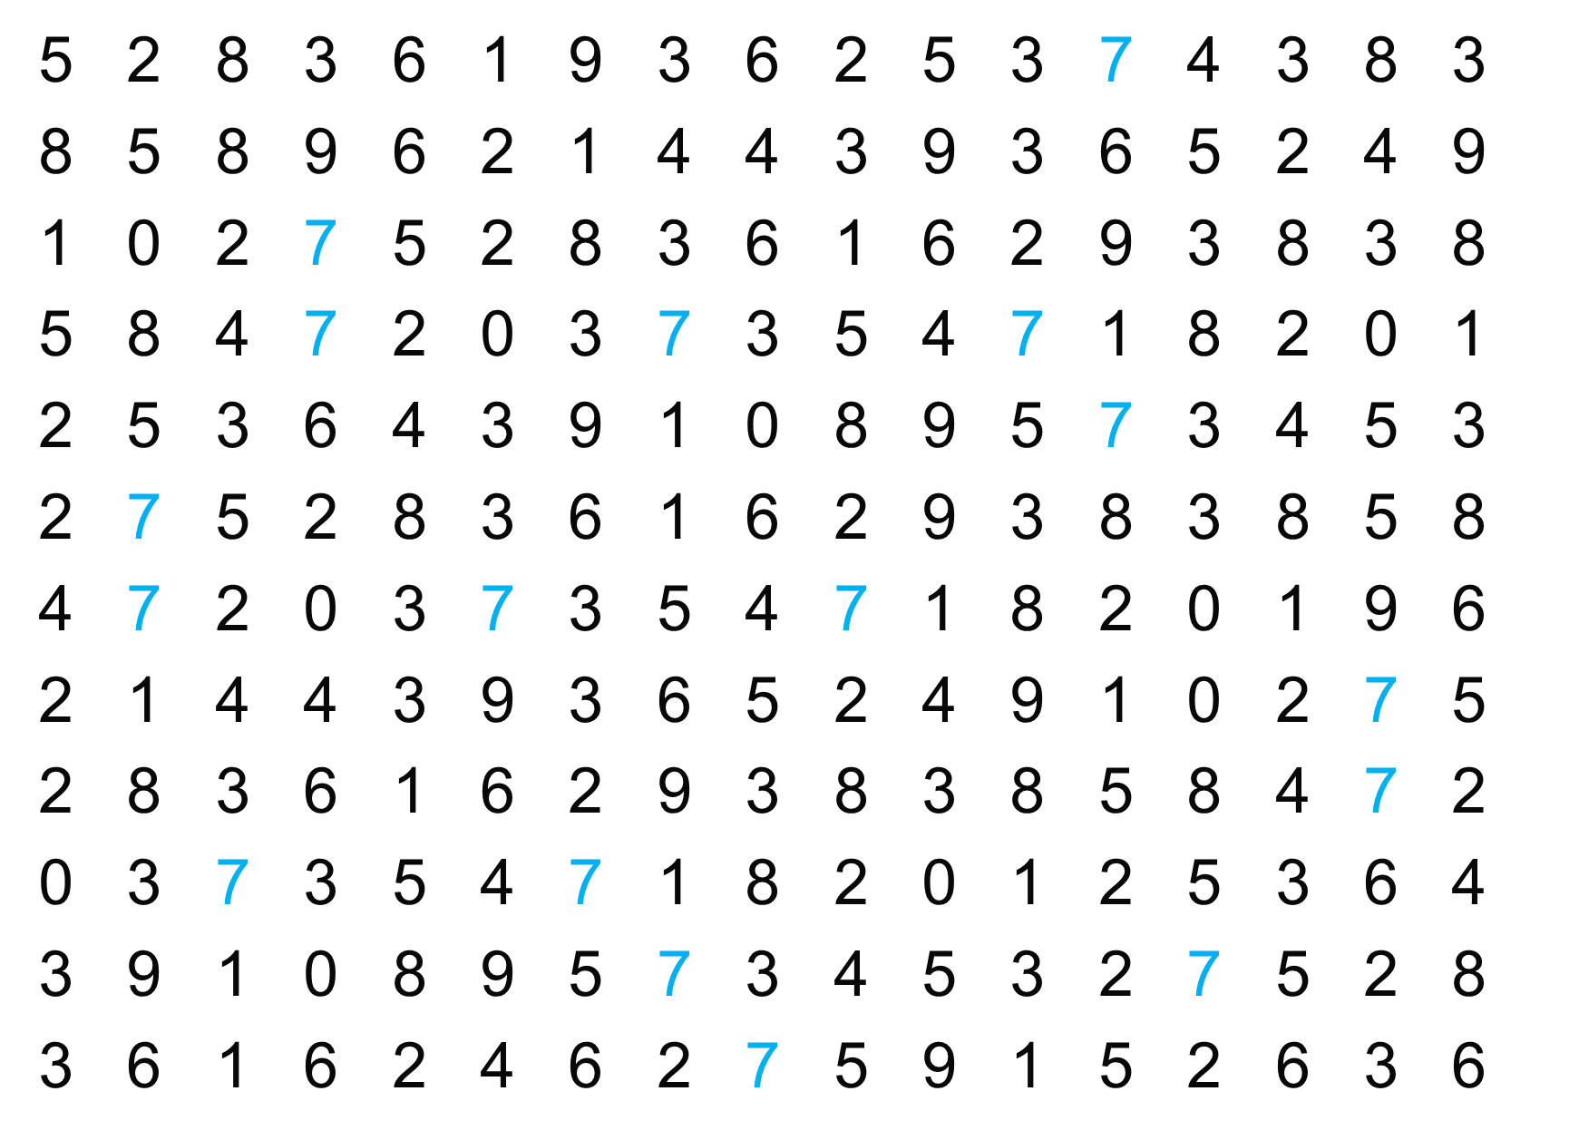
Notes:
“Is it easier now? We simply changed the color of the sevens and now it is easier to find them.”

Slide 16
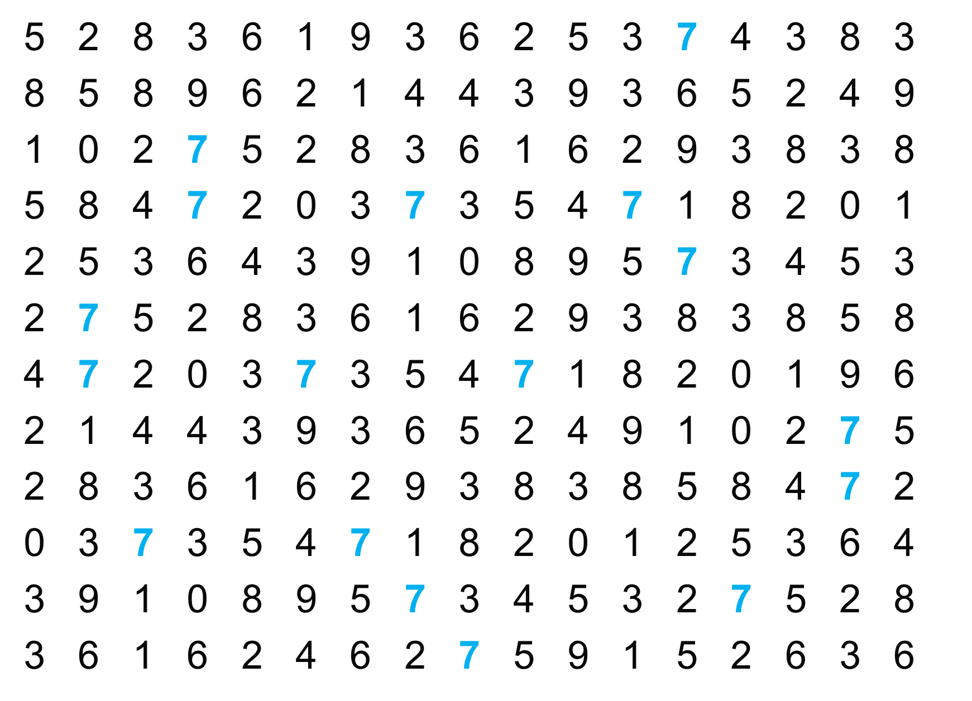
Notes:
“And now? Making it bold is easier.”

Slide 17
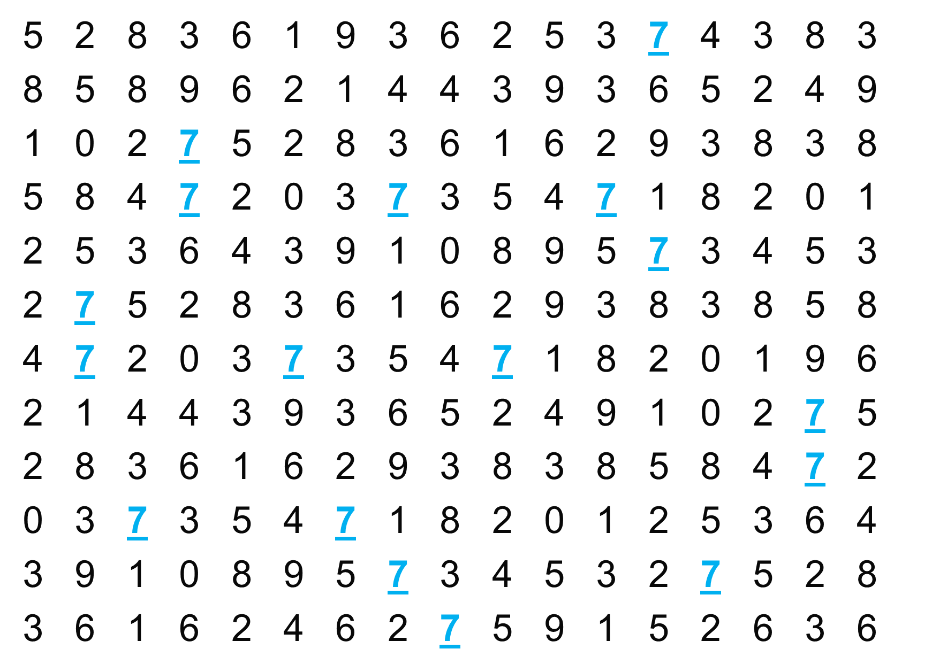
Notes:
“And underlining them.”

Slide 18
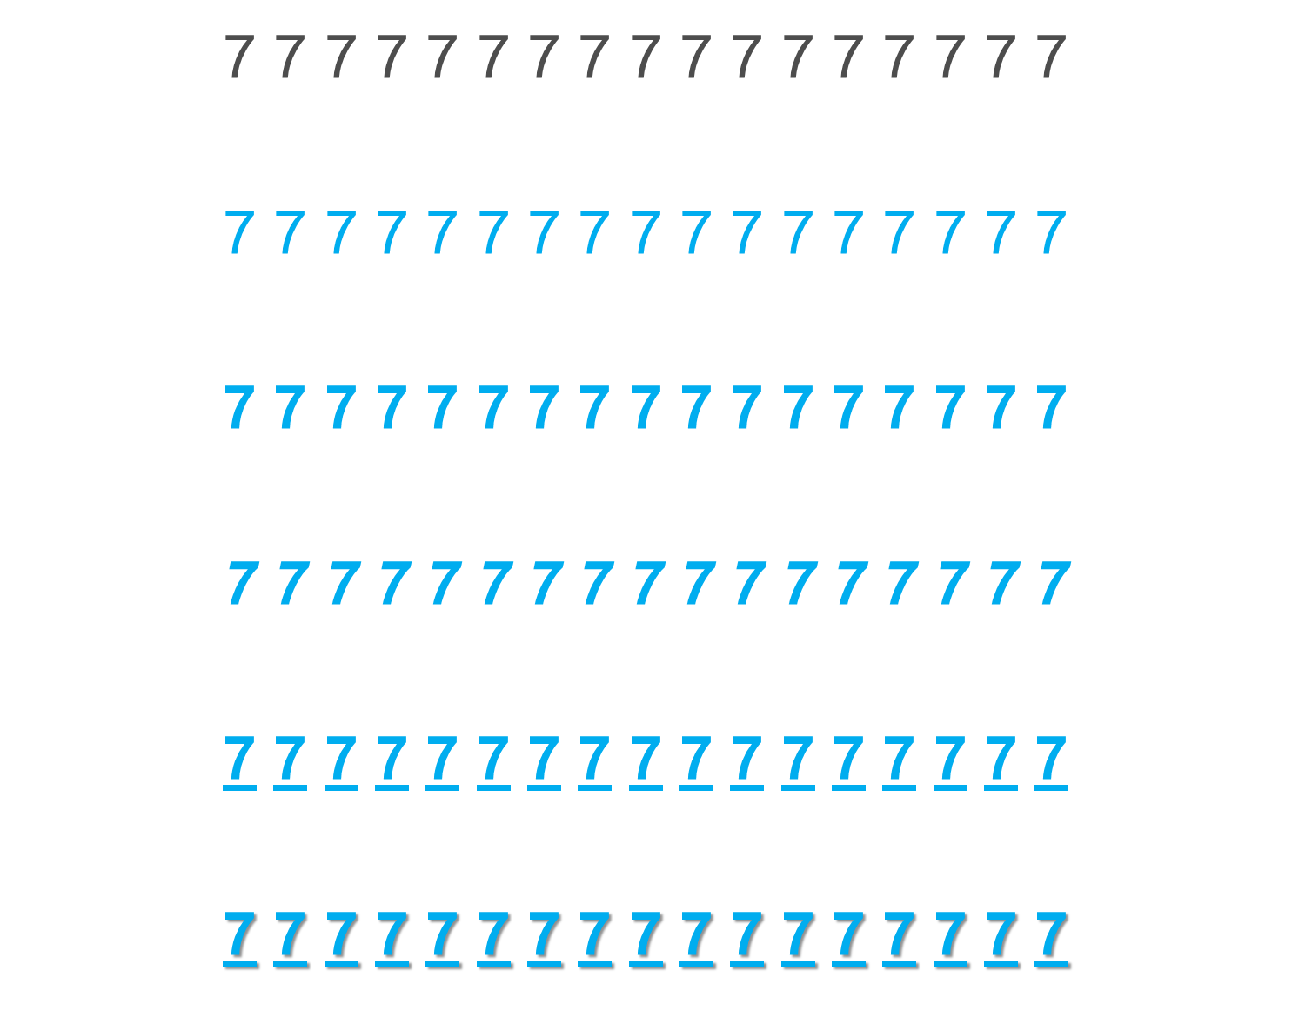
Notes:
“We can do all sort of things to make the sevens easier to see. What we are doing is using the preattentive attributes.”

Slide 19
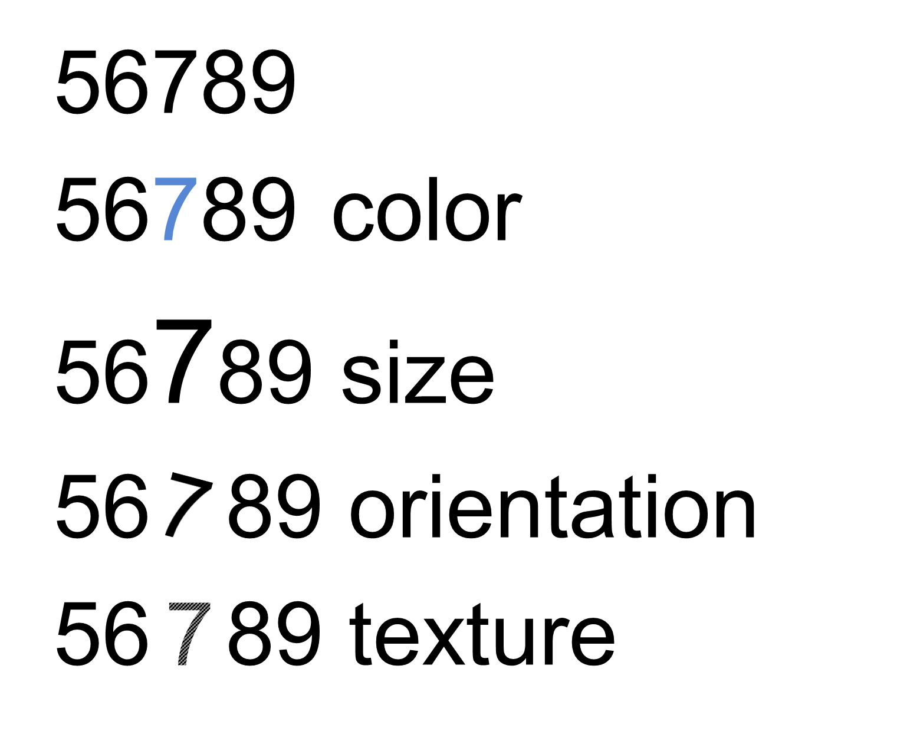
Notes:
“Things like color, size, orientation and texture are preattentive. It means the brain processes the information prior to focusing attention on anything. This happens in about 250 milliseconds.”

Slide 20
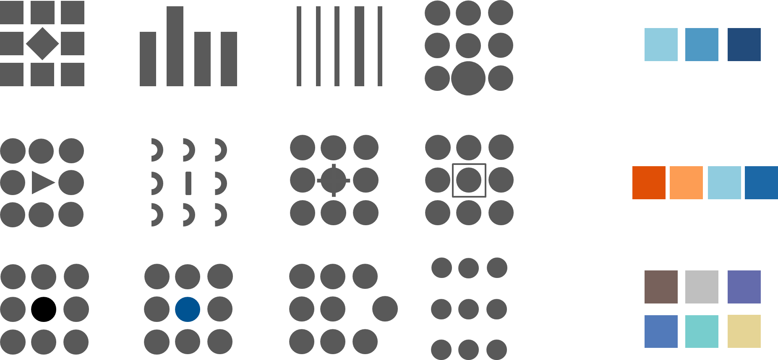
Preattentive attributes of visual perception and use of color
Notes:
“One the left we see a number of different preattentive attributes and on the right we see different ways to encode color. We can’t help but see these things immediately before processing any other information.”

Slide 21
Precise Quantitative Comparisons
Length or Width
2D Position
Notes:
“Some preattentive attributes are better for encoding data for precise quantitative comparisons. Length and width from a common baseline and Position in a two dimensional space. When two people are standing next to each other, it’s very easy for us to see that one person is slightly taller than the other person, with the common baseline of the floor. When two people are standing next to each other, it’s easy for us to see that they are one foot apart or three feet apart, even without a common baseline.” [you can use tiles on the carpet as an example if applicable]

Slide 22
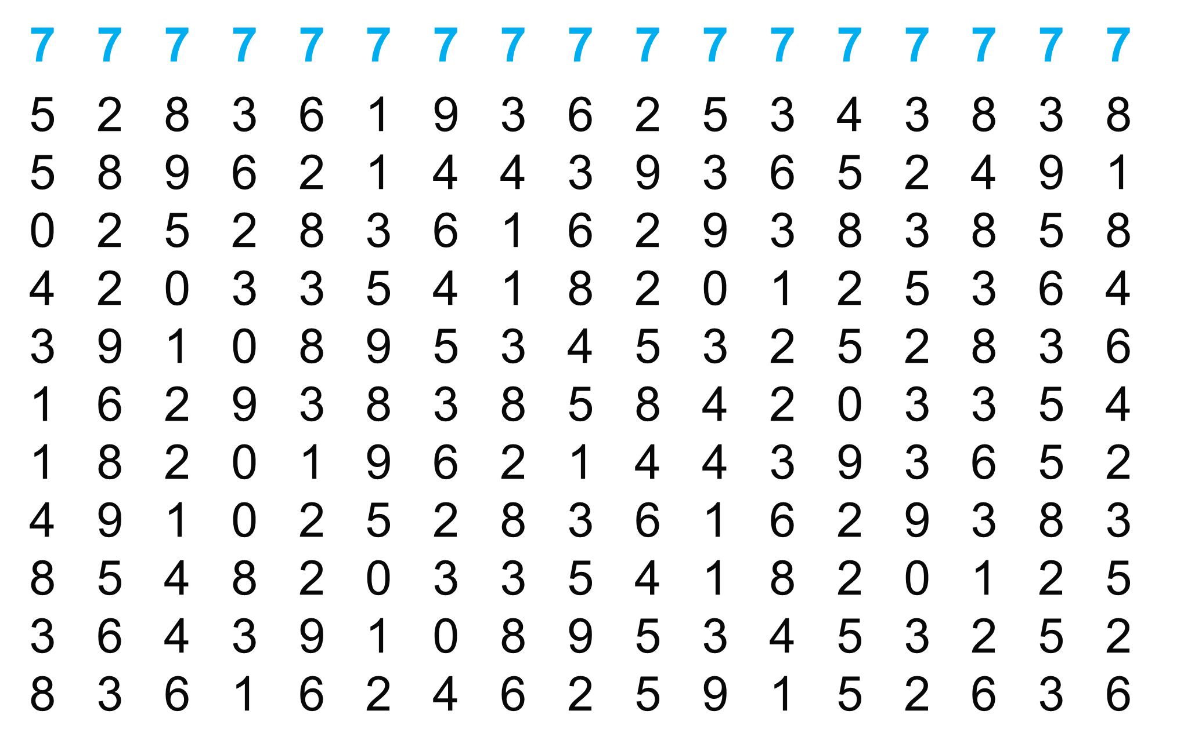
Notes:
“Order is very powerful. By ordering this data, we can now see that there is exactly one row of data. We now have information about this data that we did not have before. We are turning data into information.”

Slide 23
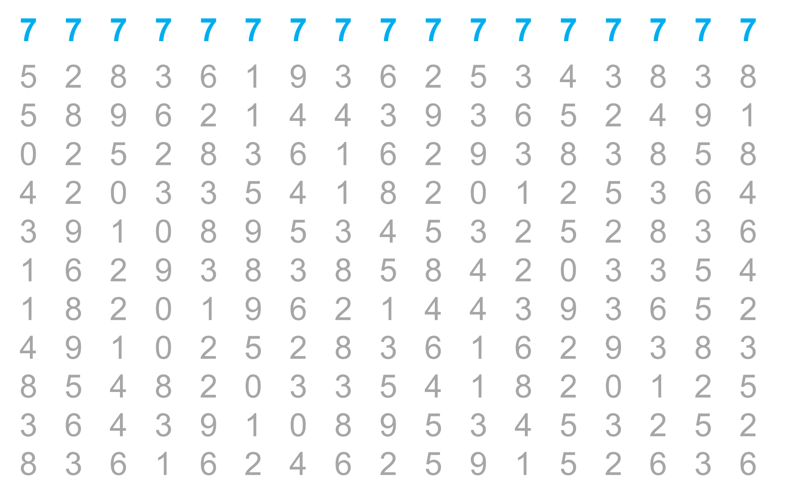
Notes:
“In this example, we did nothing to the sevens, but we changed the other numbers from black to a gray color. By doing this, it makes the sevens easier to see and allows us to encode other information with black text. For example, we could make the fives black. Once text is black and bold, you can’t go blacker or bolder. Tableau knows this and by default uses a gray color for it’s text instead of black.”

Slide 24
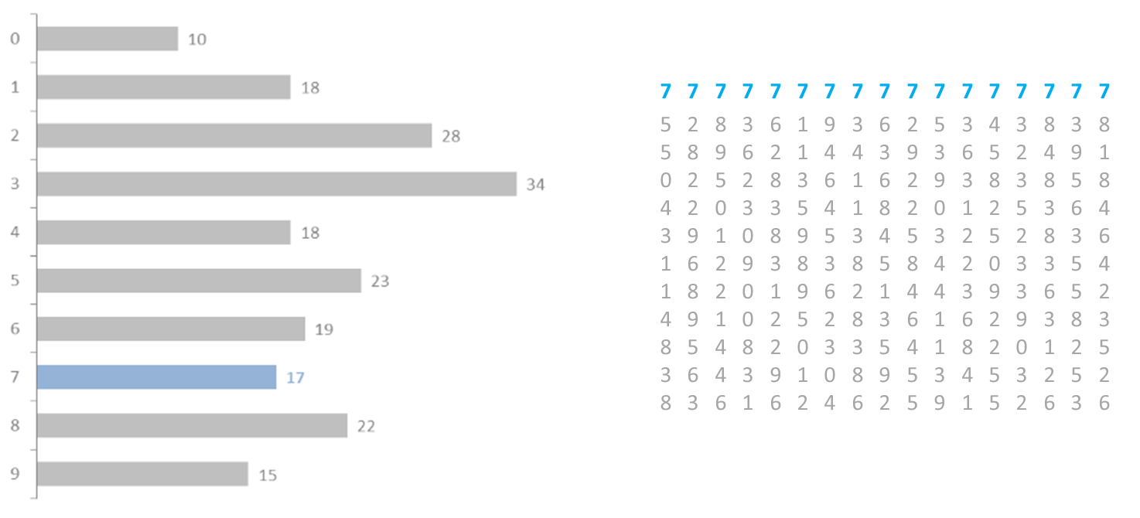
# of times digit 7 appears: 17
Notes:
“We can use charts to visualize our data and now we have more information about the data set. But just as we ordered the numbers in the grid on the right, we can do the same thing with a graph.”

Slide 25
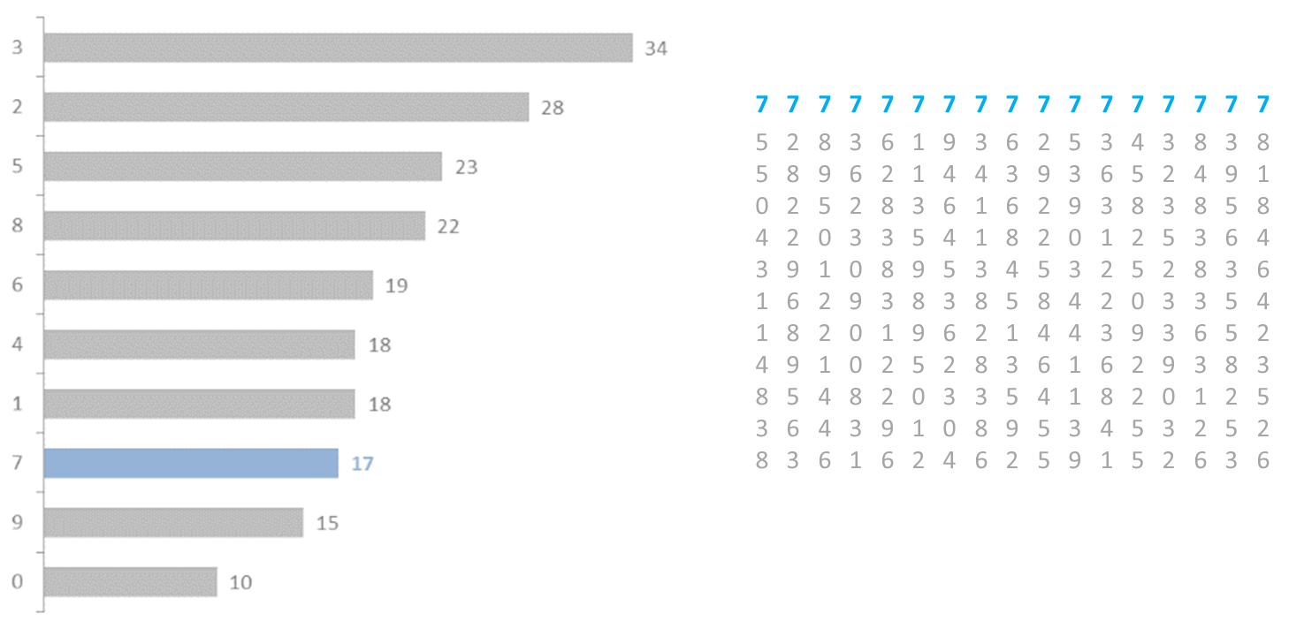
# of times digit 7 appears: 17
Notes:
“By ordering our graph, we have even more information that is readily available. For example, we now know that the sevens are the third from the bottom. We can answer questions like ‘what are the top three?’ or ‘what are the bottom three?’ or ‘what’s the second most?’ These are all very easy to see and answer quickly and accurately from the graph. Also notice how easy it is to see the sixes show up just one more time than the fours. Even very small difference are easy to see from bar charts.”

Slide 26
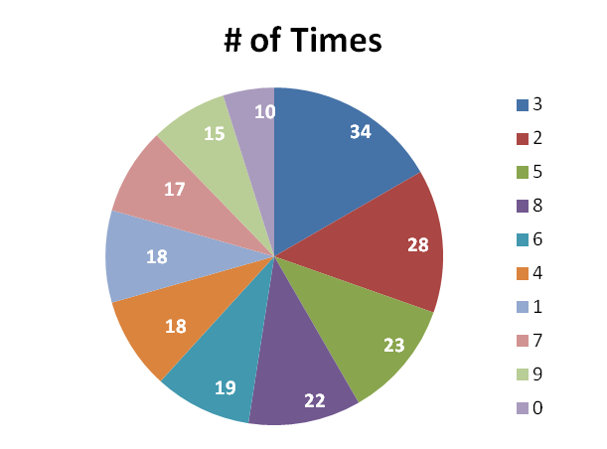
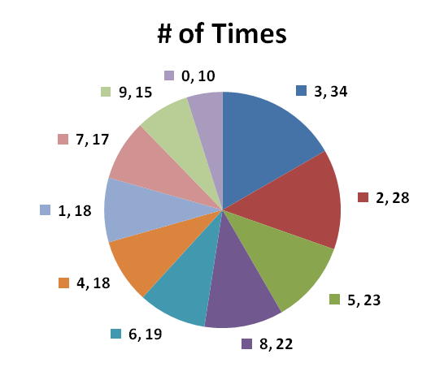
Label problems
Color problems
Hard to make visual comparisons
Do we get the same Information?
Notes:
“Compare the rich information from those bar charts to these pie charts. Try to answer the same questions as quickly and easily. Notice we have to encode with color to tell one slice from the next or we have to over label them.”

Slide 27
Business Intelligence
Moving from data to action….
_{Data}
_{Information}
How many…?
How much…?
What are…?
_{Knowledge}
Plan to guide actions or key decisions
Why are…?
How do we…?
What can we…?
Notes:
“As we move from data to information, these are the ‘how many? How much? questions’. Example, how many widgets do we have in the factory or how much were sales last month. When we move from information to knowledge these are the ‘why’ questions. The how many/how much questions are usually easy to answer. We can go to our SQL database and write a query such as, ‘select count of widgets from the inventory table where state equals Ohio’ and the SQL database will return the number of widgets in Ohio. But try going to your SQL database and typing ‘select reason why sales were low last month’. This doesn’t work. Moving from Knowledge to strategy are questions like ‘how do we or how can we’. how do we increase sales?’ how do we decrease expenses? How do we lower the defect rate? Data visualization is terrific for the how many/how much questions and if we do it well, we can often answer the “why’ questions. It’s up to the human beings to interpret that information and apply strategy to answer the “how do we’ questions.

Slide 28
A Brief History of Data Analytics
Notes:
Section Header

Slide 29
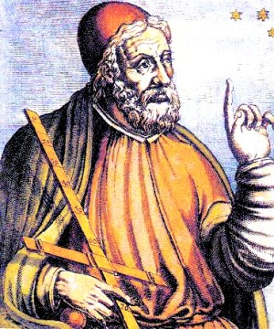
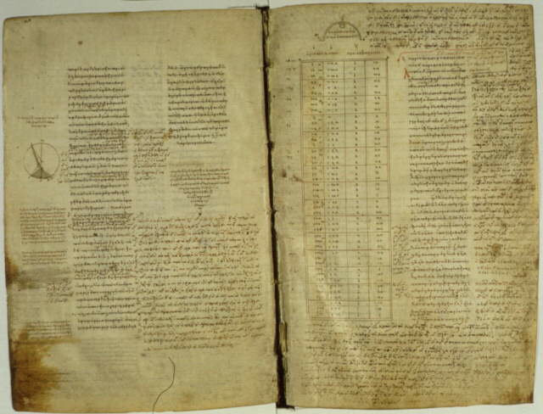
The Early Years – 2nd Century CE
A copy of the Almagest from the 9th century, in Greek, on parchment
Claudius Ptolemy publishes the Almagest around 150 CE in Egypt, providing a thorough treatise on astronomy, solar, lunar, and planetary theory¹
Earliest preserved use of a table; held detailed astronomical information²
Image of Ptolemy used under the Wikipedia Creative Commons license. http://www.wikipedia.com
Image of the Almagest from the Library of Congress. http://www.loc.gov/exhibits/vatican/math.html
Notes:
2nd century - probably in Egypt
Started first step in shifting emphasis from text to visual presentation

Slide 30
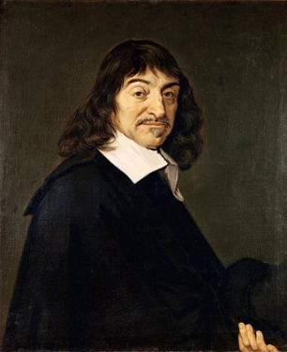
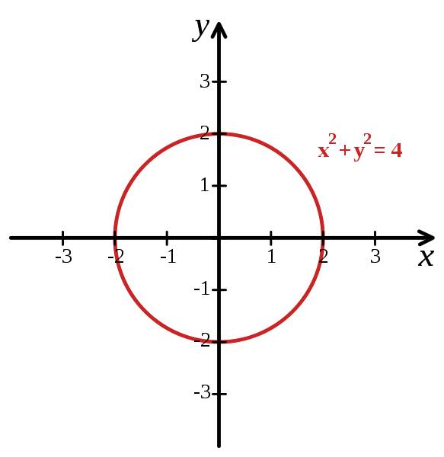
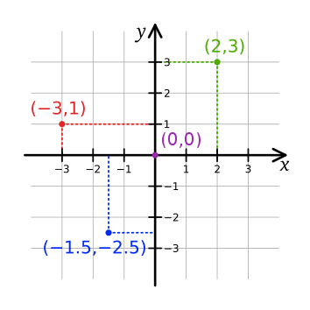
17th Century
René Descartes (1596-1650)
Invented a method of presenting number-based data using 2-D coordinate scales²
Originally designed to allow algebraic equations to be expressed visually, linking Euclidean geometry and algebra^{3,4}
Later became known as the Cartesian coordinate system³
Images used under the Wikipedia Creative Commons license. http://www.wikipedia.com
Notes:
Descartes - I think, therefore I am
The introduction of the Cartesian coordinate system

Slide 31
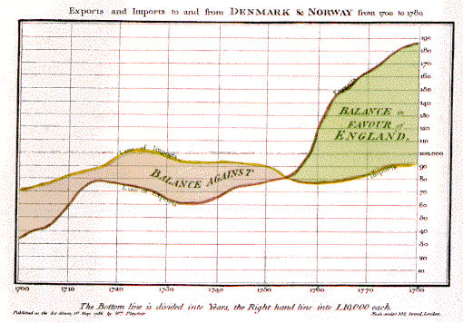
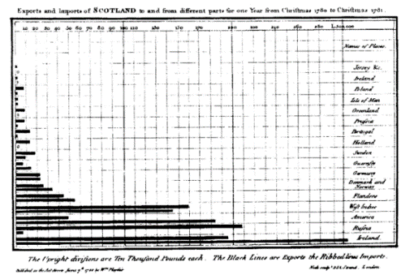
Late 18th – Early 19th Century
William Playfair (1759-1823)
Scottish engineer and political economist⁵
Founder of graphical methods of statistics
Developed new designs and improved existing methods to provide “systematic visual representations of his ‘linear arithmetic.’”⁶
Created the time-series line graph, bar chart, and pie chart.⁷
Images used under the Wikipedia Creative Commons license. http://www.wikipedia.com
Notes:
William Playfair (22 September 1759 – 11 February 1823) was a Scottish engineer and political economist, the founder of graphical methods of statistics.

Slide 32
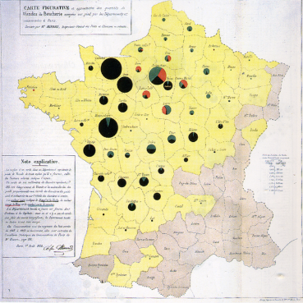

Early 19th Century
Charles Minard (1781-1870)
French civil engineer; produced an array of graphics that combine a many data points into a compelling visual story
Produced 70+ depictions including thematic maps and graphic tables between 1844-1870.⁷
Map of Napoleon’s Russian campaign regarded by some as the “best statistical graphic ever drawn.”⁸
Images used under the Wikipedia Creative Commons license. http://www.wikipedia.com
Notes:
We will discuss the map of Napoleons March in later slides.

Slide 33
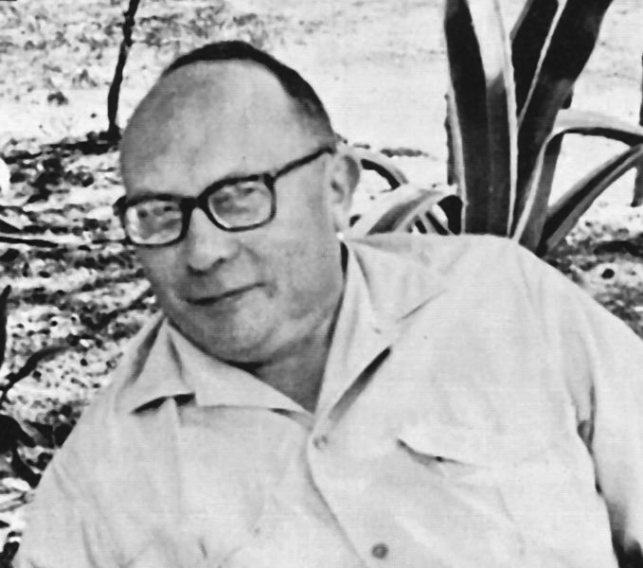
20th Century
Jacques Bertin (1918-2010)
French cartographer and theorist
Author of many scientific maps, articles, and other papers on semiology, the study of signs, and how we process visual information
1967 – Published Sémiologie Graphique (Semiology of Graphics), asserting that our visual perception follows rules that can be followed
Images used under the Wikipedia Creative Commons license. http://www.wikipedia.com
Notes:
The Semiology of Graphics describes the preattentive attributes as it related to graphics, which are the fundamental building blocks of data visualization.

Slide 34
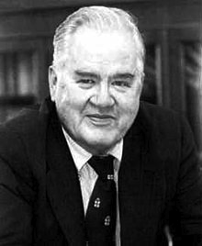
20th Century
John Tukey (1915-2000)
American statistician
Introduced the box plot in Exploratory Data Analysis, published in 1977
Exploratory Data Analysis (EDA) emphasized presentation of the main characteristics of a data set in a visual, easy to understand form, without using a statistical model or hypothesis¹⁰
Images used under the Wikipedia Creative Commons license. http://www.wikipedia.com
Notes:
John Tukey was an American Statistician who worked at Bell Labs. He developed and wrote about Exploratory Data Analysis or EDA. He advocated for showing data in a visual manner as an easy way to understanding, with the need for a statistical model or hypothesis. He invented the box plot, also known as the box and whiskers plot, and also wrote about other plots such as the bag plot and violin plot.
Tukey also coined the term “bit” as a contraction of “binary digit”

Slide 35
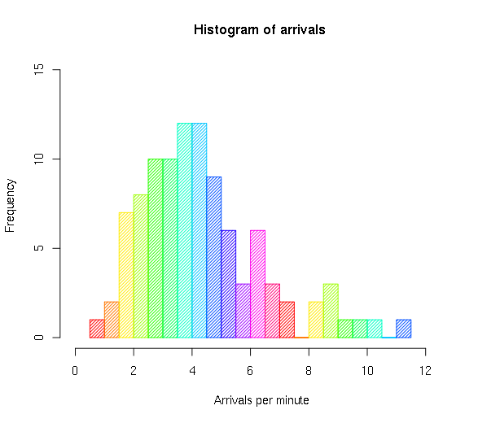
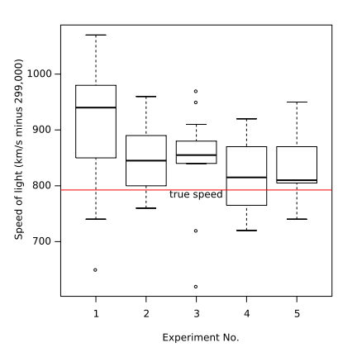
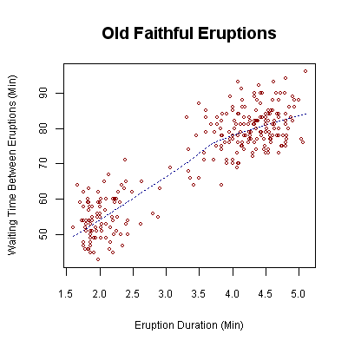
20th Century
Visualization techniques used in EDA include:
Box plot
Histogram
Pareto chart
Scatter plot
Sample histogram.
Sample box plot.
Tukey’s advocacy for EDA encouraged the development of software for statistical computing like S, which inspired S-Plus and R.¹⁰
Sample scatter plot.
Images used under the Wikipedia Creative Commons license. http://www.wikipedia.com
Notes:
In Exploratory Data Analysis, Tukey used visual techniques such as the box plot, histogram, Pareto Chart and Scatter Plot.

Slide 36

Contemporary Practitioners
Edward R. Tufte (b. 1942)
American statistician, sculptor, and Professor Emeritus of Political Science, Statistics, and Computer Science, Yale University
Widely recognized expert in the fields of information design and visual literacy¹¹
Credited as a pioneer in teaching the fundamental skills required for visual communication³
Edward Tufte photo from http://www.edwardtufte.com/bboard/images/0003mW-10280.jpg
Notes:
Edward Tufte was one of the early authors in the field of data visualization.

Slide 37
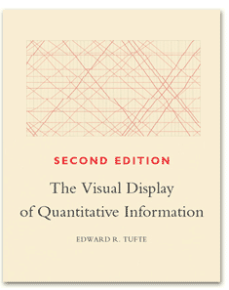
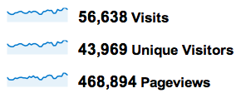
Contemporary Practitioners
Edward R. Tufte
The Visual Display of Quantitative Information (1983)
Provides an essential reference for how effective design can positively influence understanding
Tufte also invented sparklines
Notes:
Tufte invented the ‘sparkline’ which we will discuss in other modules.

Slide 38

Contemporary Practitioners
William S. Cleveland
Professor of Statistics and Courtesy Professor of Computer Science at Purdue University; previously worked at Bell Labs
Authored over 100 papers/publications including Visualizing Data (1993) and The Elements of Graphing Data (1994), to enhance awareness and provide examples of effective data presentation
Initial developer of trellis charts, which make visualization possible in data sets with multiple variables
William S. Cleveland photo from http://www.stat.purdue.edu/~wsc/
Notes:
Bill Cleveland is another important author in the field of data visualization. His early books are foundational. He is one of the first to study how people perceive information and these studies are the pivotal research that is often cited and built upon to create data visualization best practice.

Slide 39
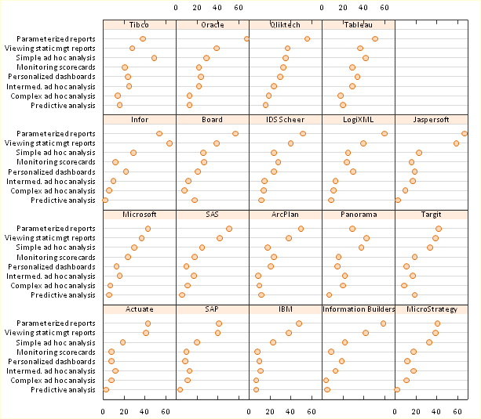
Trellis Chart Example
Graphic from http://peltiertech.com/WordPress/trellis-plot-alternative-to-stacked-bar-chart/
Notes:
Bill Cleveland also invented the Trellis Chart. An example of the Trellis chart is shown here comparing technology platforms.

Slide 40

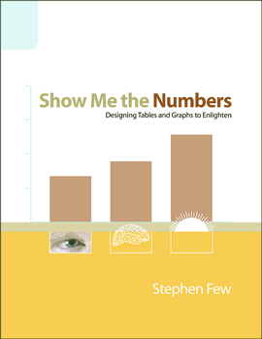

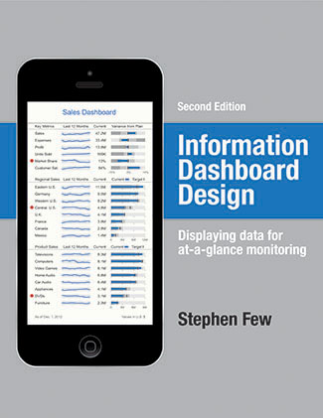
Contemporary Practitioners
Stephen Few Prolific writer and author with a focus on designing simple information displays that are effective and communicative. Books include:
Show Me The Numbers (2004)
Now You See It (2009)
Information Dashboard Design, 2nd ed. (2013)
Several of Few’s examples will be used in class.
Few’s biography retrieved from http://www.perceptualedge.com/about.php
Notes:
Stephen Few attended one of Edward Tufte’s courses and has becomes a leading author in the field of data visualization. His books are great resources for the fundamental concepts of data visualization in business.

Slide 41
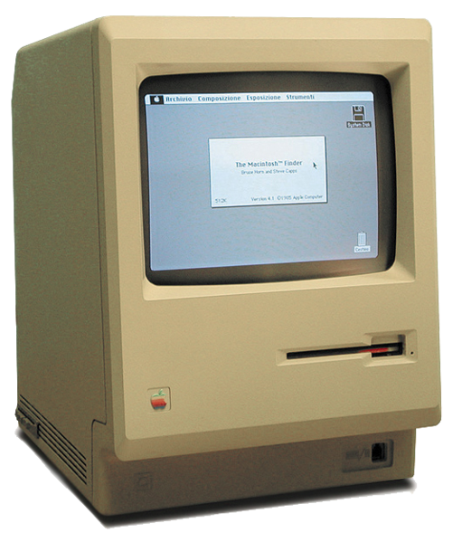
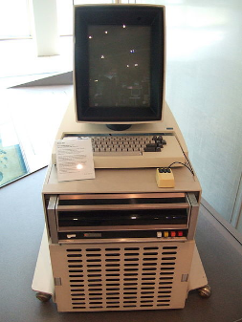
Other Critical Events
1984 - Apple Computer introduces the Macintosh
The Macintosh was the first popular and affordable computer designed to display graphics in an interactive interface.³
Innovations, like the graphical user interface and mouse, are invented at Xerox Palo Alto Research Center (Xerox PARC).
Images used under the Wikipedia Creative Commons license. http://www.wikipedia.com
Notes:
Other important events include the PC computer and innovations such as the graphical user interface

Slide 42


“I See”
“Show me”
Visual Perception
Notes:
[NOTE – the visual perception slides are best shown with good, high resolution projector. It might be best to show this portion of the slides with the lights off in the room or turned off in the front where the projector is showing on the screen.]
“Before studying data visualization, it is important to understand how the minds works. We wake up in the morning and we don’t give this a second thought. Our minds are wired in a very specific way and this wiring can play tricks on us. There isn’t anything we can do about this, it’s just the way our minds work and this is very important as we try to understand how to visualize data.”

Slide 43
Optional Video Brain Games
Notes:
[Clips from episodes 1 and 2 can be used as optional videos.]
Brain Games Various Clips (Season 1, episodes 1-2)
Episode 1 - https://youtu.be/Rq_K4pfdHzQ
00:00 to 15:30
32:45 to 38:10
Episode 2 - https://youtu.be/tzltfk5jH7U
00:00 to 12:00
34:00 to 35:45

Slide 44
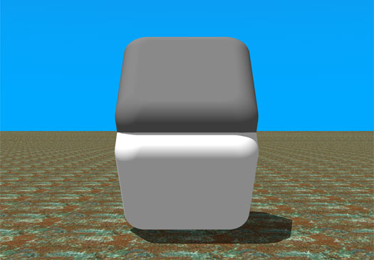

Used by Permission of Dr. Beau Lotto (www.LottoLab.org)
Notes:
This image was created by Doctor Beau Lotto of Lotto Labs (it’s also featured on the Brain Games videos if you play any of them). Explain to the students, this is an object that appears gray on the top and white on the bottom. This is exactly the same color. You will prove it to them with the slide animation. As Dr. Lotto explains, we live in a world of a single light source from above. The perceive the top portion of this object to be a well-lite gray surface and the bottom part of the image to be a poor-lite white surface in shadow. There is no shadow in this image.

Slide 45
DATA
DATA
Notes:
“This is an example of gradient color. The word “DATA” appears to be purple on the top and yellow on the bottom. They are exactly the same color. The background is a gradient color going from yellow to blue. Context is everything. The color around the letters affects the way that we perceive the color of the letters. The slide animation will show the word traveling from the top to the bottom and will appear to change colors. Context is everything.”

Slide 46
DATA
DATA
Notes:
This is the color of the words “DATA” without the gradient background color.

Slide 47

Notes:
[this slide is animated on click to remove the gradient background color]
“In this example, the bar appears to go from light gray on the left to dark gray on the right, but the bar is exactly the same color. The background is gradient, going from dark to light and this affects the way that we perceive the color of the bar. Once I remove the background color you can see that the bar is exactly the same color across.

Slide 48

Notes:
[animated slide moves the bars]
“How many colors do you see? Do you see two? Light blue on the left and dark blue on the right?”
[click animation]
“there are actually four colors”

Slide 49
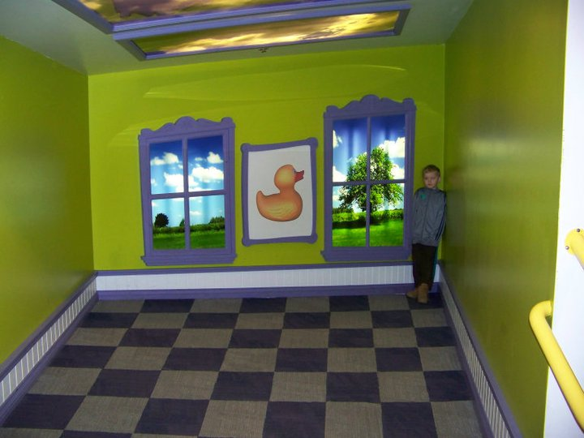
Notes:
[Flip back and forth between this slide and the next slide. ]
This boy is standing in one side of the room and then on the other side of the room. It’s the same boy in the same room. Ask the students, “what is happening here?”

Slide 50
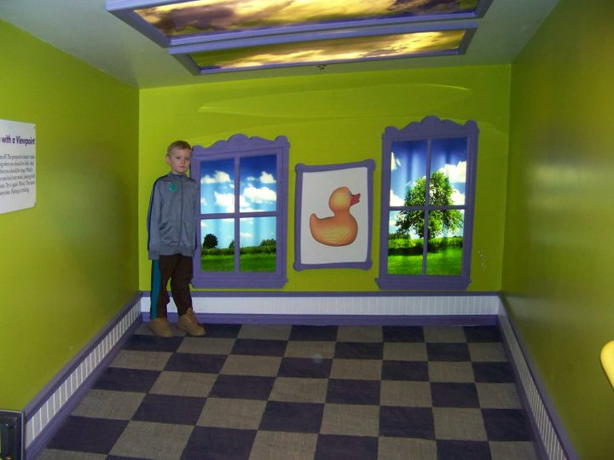

Slide 51

Notes:
You can give them a clue, it’s the same thing that is happening in this image. The Washington Monument is obviously not this small. It’s simply further in the distance, making it appear smaller.

Slide 52
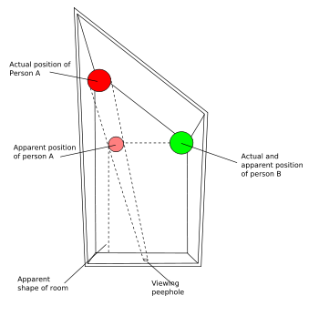
Notes:
This is called an Ames room. The back wall is not built straight, therefore, one side of the back wall is further back in the distance vs. the other side of the back wall.

Slide 53
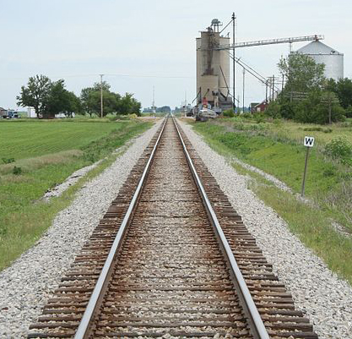
Source: Wiki Commons (Lotus, Illinois Railroad Tracks)
Notes:
Another example of how humans perceive distance. The line “in the distance” appears to be longer and the other one shorter. The lines are exactly the same size.

Slide 54
Notes:
This is another example of shadow. We see some of these buttons (the letter H) as stuck out and the other two pressed in. Our minds expect light coming from above, putting the top of the buttons in light and bottom parts in shadow. The ones pressed in are the opposite. Slide animation will rotate this slide to show the opposite effect.

Slide 55
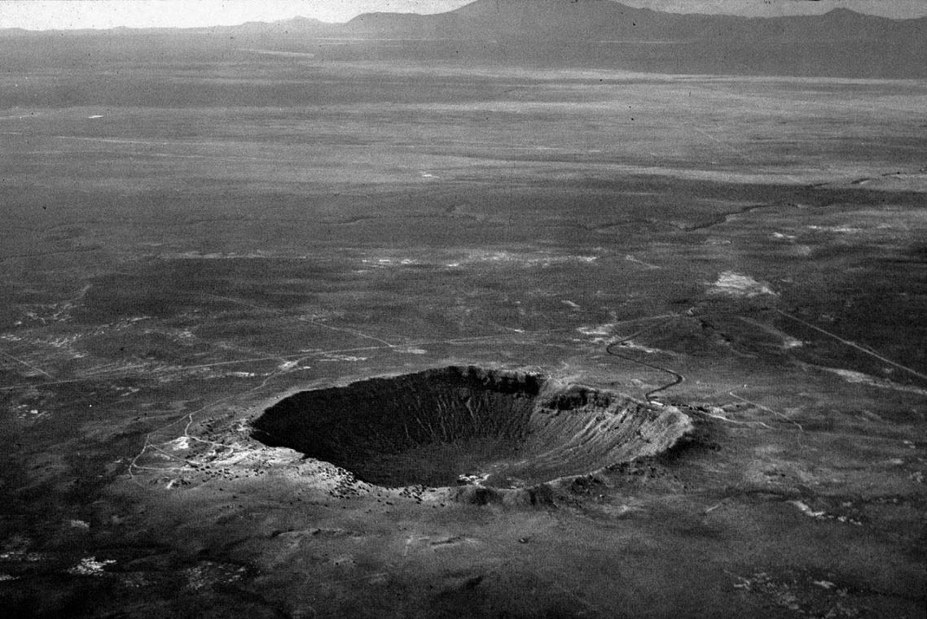
Source: Wikipedia (from the Lunar and Planetary Institute: http://www.lpi.usra.edu)
Notes:
This is a picture of a crater from Wikipedia. Watch what happens when we rotate this slide. Now we have to climb the hill.

Slide 56
The Moiré effect
Notes:
This is called the Moire Effect. Notice the ‘shimmer’ that occurs when you stare at this image. There is no animation here.

Slide 57
Notes:
This ‘shimmering effect’ is even worse when one grid is one top of another.

Slide 58
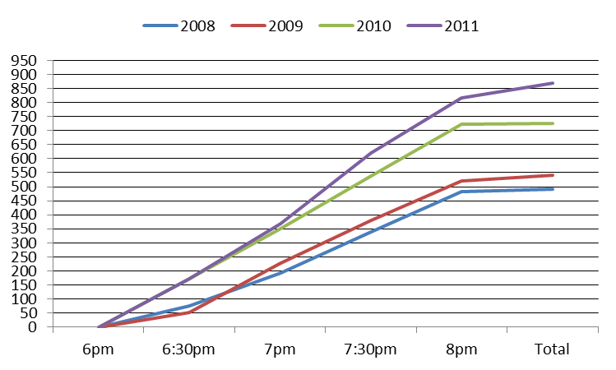
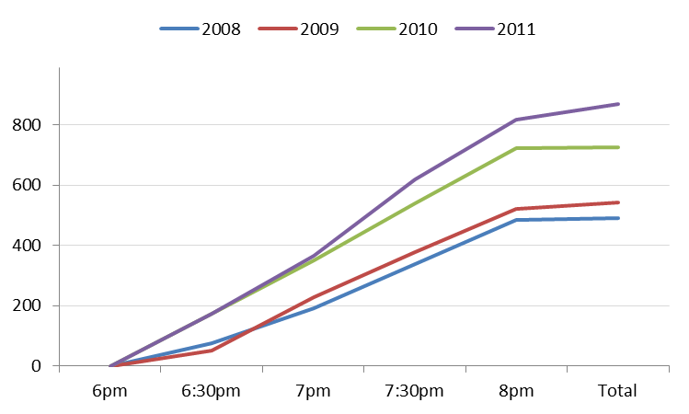
Gridlines spaced and muted
Notes:
We can see this in data visualization with gridlines and bar charts. In the example on top, the gridlines are dark and narrowly spaced in increments of 50. Notice that the gridlines get in the way of visualizing the trend in the lines. On the bottom, the gridlines are gray spaced wider in increments of 200.”

Slide 59
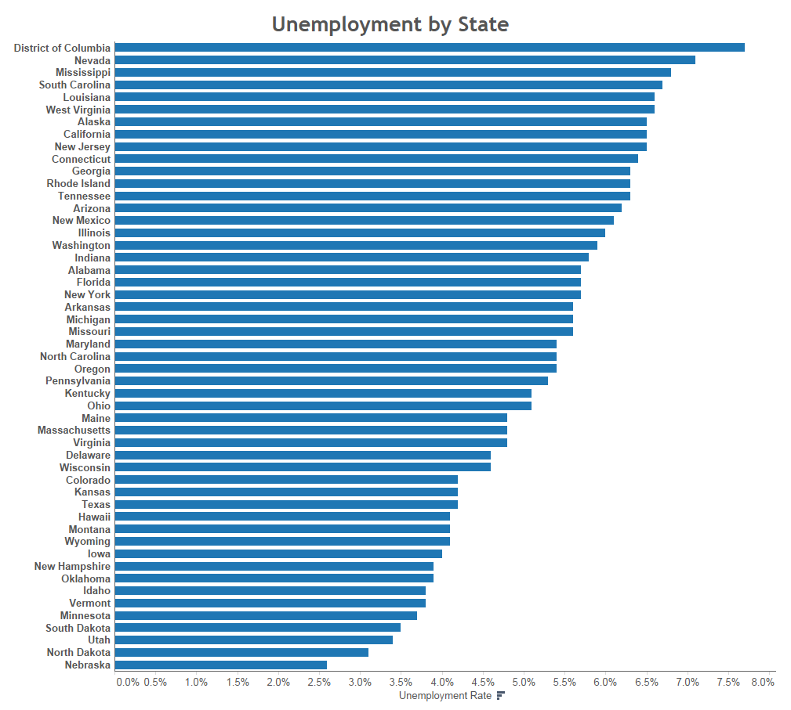
Notes:
Here is an example where the Moiré effect occurs when there are so many bar charts.

Slide 60
The Hermann effect
(the scintillating grid)
Notes:
The Hermann effect, also known as the scintillating grid, shows dark dots in between the squares. This distracting effect is visible as an after effect when our eyes move around the grid.

Slide 61
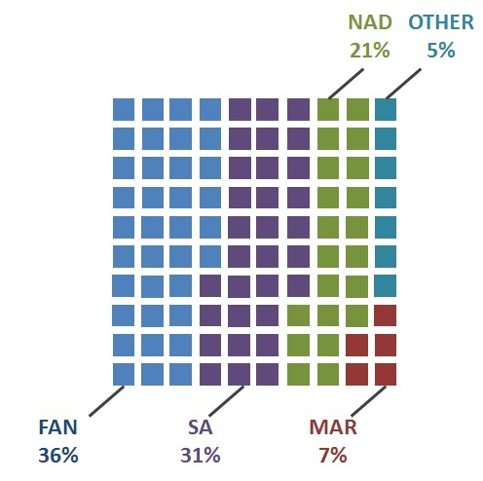
Unit Chart
(notice Hermann effect)
Notes:
This can sometimes be seen in unit charts or waffle charts.

Slide 62

Gestalt Principle - Closure
(Kanizsa triangle)
Notes:
Stare at this image and see if you can see the white triangle that is on top of the three red circles. There is no triangle or circles. They are actually three Pacman shapes, but we can see the white triangle.

Slide 63

Gestalt Principle - Closure
Notes:
In the same way, we can see the circle, the triangle and the rectangle around them. But none of these are complete shapes. Our mind will work with the information we have, and compare the image with our past experience of these objects. We can recognize them as a circle and a triangle, even though they are not complete.

Slide 64
What letter is this?
T
C
T
E
Adapted from Lera Boroditsky as seen on Brain Games
Notes:
In this example, is this the letter A or the letter H? When we see this in context with other words, we are able to determine their meaning even though it’s not a complete letter. We can read this as THE or CAT.

Slide 65
Notes:
Another Gestault Principle is the proximity principle. By encoding squares with different colors we group them together.
[Ask the students] “are there more blue, white or red squares?”
[Most will say blue, although as you work through these visual perception slides they will figure out these are all illusions or tricks of the minds.]
There are exactly the same number of each color squares. Click 3 times and the slide animation will group each color together.

Slide 66
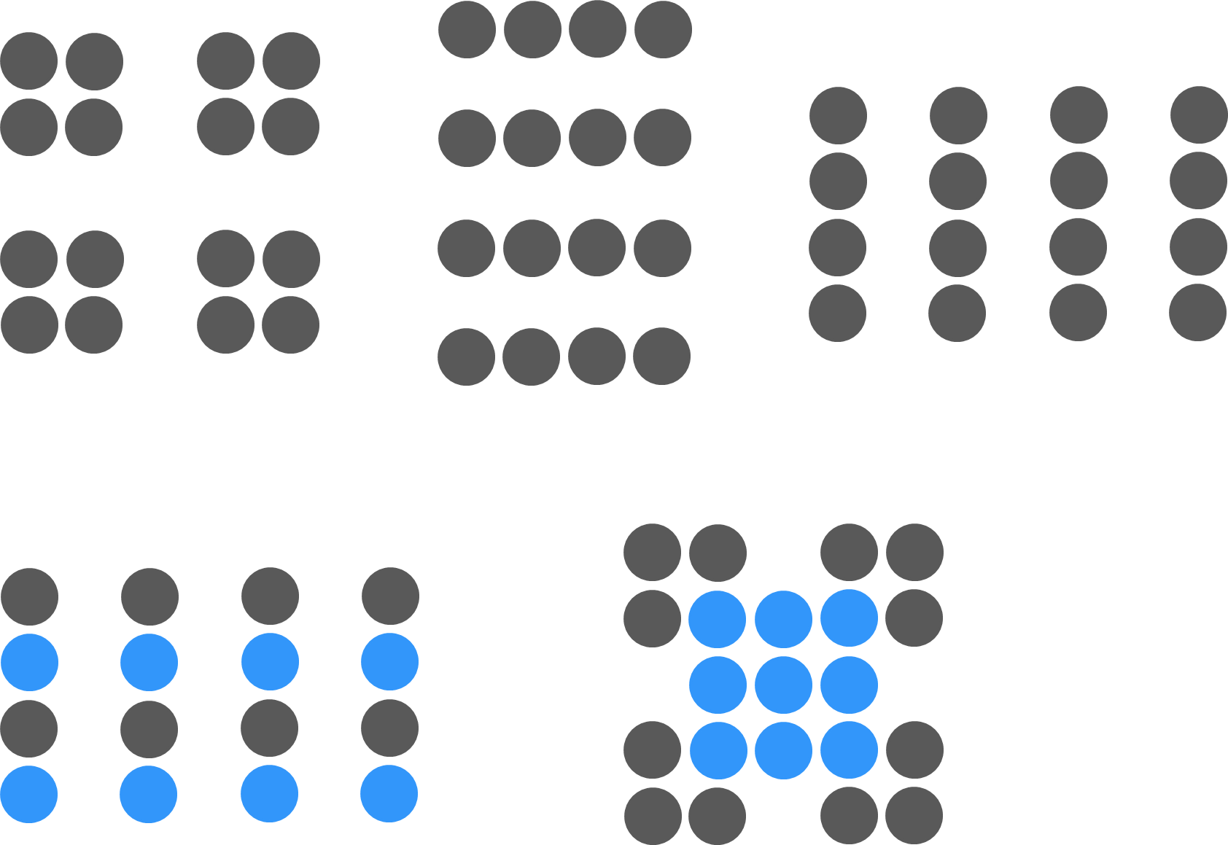
Notes:
Objects that are near each other will appear to belong together. Just adjusting the spacing a little bit creates four squares, four rows or four columns. By adding color, we can show four columns, but alternating two row colors. And by combining color and proximity with can show a blue square that is framed by the other dots. These are all done with minimal shifting of the dot position and color.

Slide 67

Notes:
[Ask the students to stare at the black dot for about 20 seconds. Then change to the next slide. During the 20 seconds you can explain what is going to happen.]
Stare at the black dot for about 15 to 20 seconds. The brain is processing this information, but after a short period of time the image is embedded in our brains. The brain operates on a very small amount of energy and so it has to work efficiently. It basically says, ‘I got it. No need to keep processing the same information.’

Slide 68
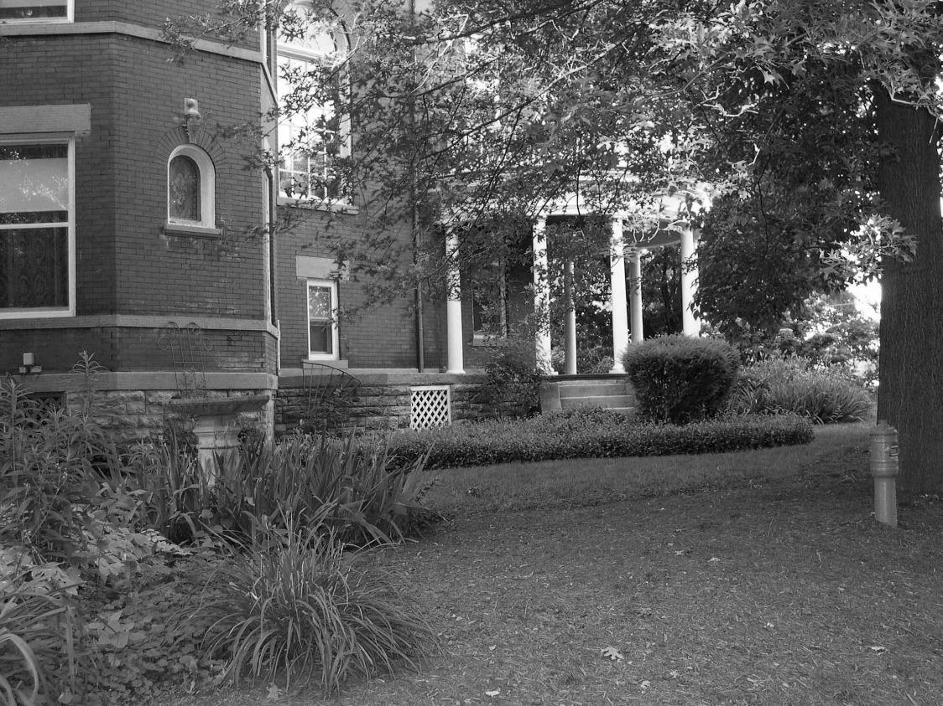
Notes:
This is a black and white image that will appear in color at first, because the brain has the previous slide in memory with the color.
[this might be worth repeating as students have fun with this one]

Slide 69

Notes:
[Ask the students to stare at the red dot on the woman’s nose for about 20 seconds.]
Let’s do another one. Stare at the red dot on the woman’s nose for about 15 to 20 seconds. This time I’m not going to show you any picture, just a blank screen.”

Slide 70
Notes:
[The image of the woman will project on the blank screen]
Now you can tell everyone that you saw a ghost in the data visualization class.
[this might be worth repeating as students have fun with this one]

Slide 71
Putting it all together
We live in a world that is rich with data
Tools let us look at the past, present, and “try out” future scenarios
Ultimately, we want to understand our world and make better choices, change behavior, grow wealth, improve quality of life, etc.
We discover how to do these things by asking questions through data…

Slide 72
Putting it all together
The understanding and interpretation of data is an activity of human cognition
Asking questions, discovering patterns, drawing meaning from the data
Creative, visually-driven process; also requires empirical and mathematical skills
Requires subject matter knowledge
Built-in rules (or at least, guidelines) affect the way we process information

Slide 73
Easy, right? Not so fast…
Software promises to reveal the answers…but…
Computers can’t figure out what our data means, how it connects to the business or problem, and what to do
Data needs are changing (e.g., big data)
Users expect “iPhone easy”
We don’t train for visual intelligence
Data + tools + brains >>> business intelligence

Slide 74
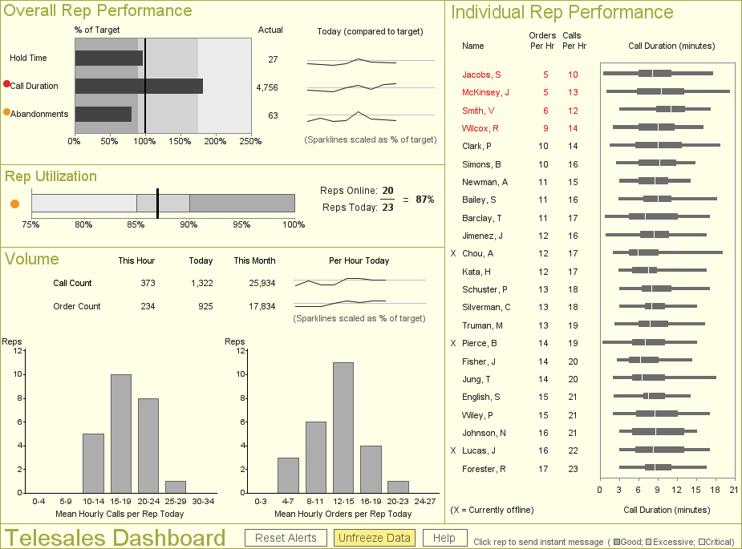
Most people agree that this is data visualization…
Source: Information Dashboard Design (2 Ed.) by Stephen Few
Notes:
This is a call center dashboard featured in Stephen Few’s book, Information Dashboard Design. This would certainly be considered data visualization.

Slide 75
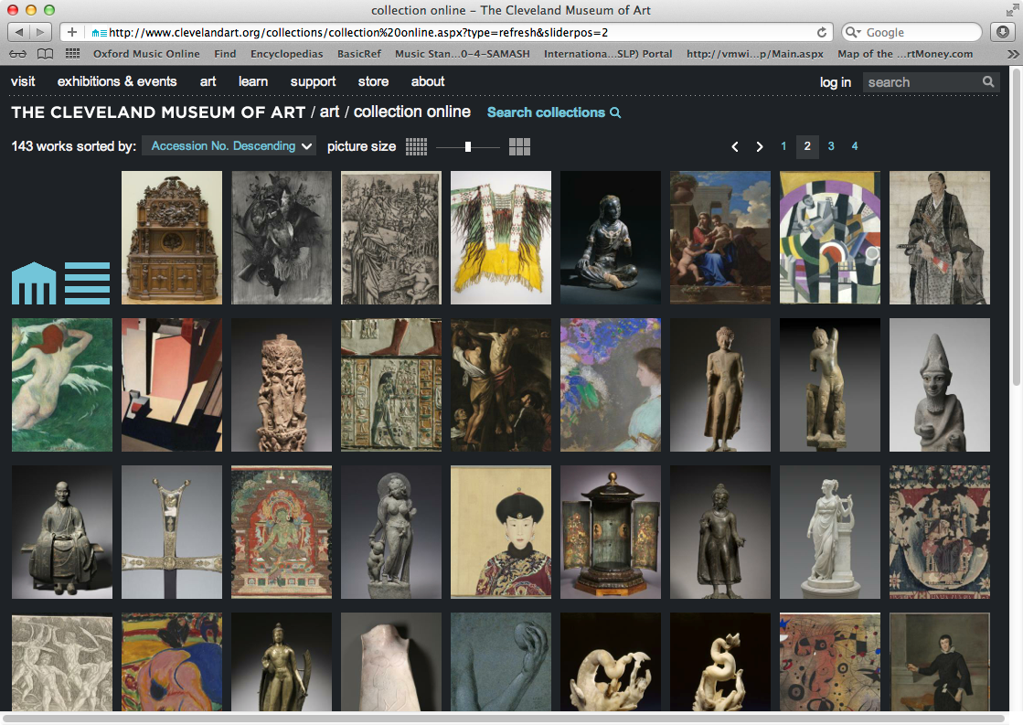
Stretching our thinking about data…
…what about this?
Source: http://www.clevelandart.org/art/collection/search
Notes:
What about this? This is the website of the Cleveland Museum of Art. The data is the pictures of the art in the gallery.

Slide 76
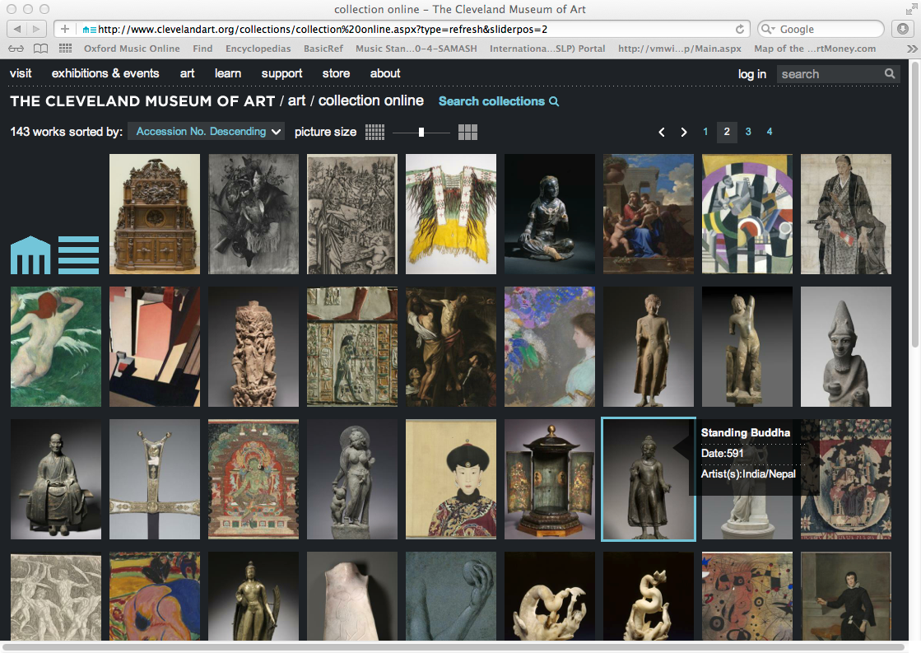
Stretching our thinking about data…
…what about this?
Source: http://www.clevelandart.org/art/collection/search
Notes:
We can hover and click over the data. We can sort the data ascending or descending and filter by picture size.

Slide 77

Notes:
Clicking on an image brings up the details of the piece. The date, the medium, the dimensions and the type of work.

Slide 78

Notes:
And we can drill down into all the details.

Slide 79
Concluding Thoughts
Ultimately, we’re trying to understand our world and make better choices, change behavior, enhance wealth, or improve quality of life.
Learning more about the way our brains work, how we perceive and process data, and improving how we practice visualization is essential to achieving these goals.

Slide 80
The Building Blocks of Data Visualization

Slide 81
We are born with an enhanced visual path to cognition
Approximately 70% of sense receptors are in our eyes
40% of the cerebral cortex is involved in processing visual information
The visual connection to the brain has more bandwidth than other paths
Visual perception is intimately connected to understanding
This is reflected in language
- “I see what you’re talking about…”
- “Sketch out the idea…”
- “Seeing is believing…”

Slide 82
Our brain is powerful… but working memory is limited
Long-term memory is very important
Working memory limited to a small number of “chunks”
Visualization allows us to consolidate complex statistics so we can process more data simultaneously (seeing the forest along with the trees)
The picture is not the end goal – It’s what we do with it that is important

Slide 83
Making sense of our visual world…
According to Bertin, our perception of data on a typical printed page is associated with the following visual variables:⁹
Shape
Orientation
Color
Texture
Value
Size
…and the two planar dimensions (x and y) which are encoded in Position and Order.
Based on the contemporary preponderance of digital technology, these factors have also become critical:
Motion – animated presentation of frames of data
Medium – the physical strata on which data is displayed
Context – the sensory and emotional environment

Slide 84
Shape
Notes:
Shape is a preattentive attribute. Notice in these examples we also see the Hermann Effect with the scintillating grid.

Slide 85
Shape
Notes:
It’s easy to see the different shapes. This could be useful for categorical comparisons, but would not be useful for a quantitative comparison.

Slide 86
Orientation
Notes:
Orientation is another preattentive attribute.

Slide 87
Orientation
Notes:
Similar to shape, this could be useful to show a categorical comparison or as a directional icon. For example, an arrow pointing up could mean something has increased and an arrow pointing down could mean something decreased.

Slide 88
Color (Hue)
Notes:
When people think about color, they typically mean color hue. The color blue versus the color red. This is a very powerful preattentive attribute. In data visualization.

Slide 89
Color (Hue)
Notes:
We can draw the reader’s attention or alert them to something important.

Slide 90
Changes to the HUE (color)
Changes to the SATURATION (intensity)
Changes to the Value (brightness)
Notes:
Color is more than just color hue. There are many different color models.
RGB: Red, Green Blue which was maps these colors to the color receptors in the eyes
HSV: Hue, Saturation and Value
HSL: Hue, Saturation and Lightness
RGB, HSV and HSL are all very common color models in computer graphics.

Slide 91

Notes:
“Does anyone know what this is called?”
“This is called a color wheel”
This is actually a RYB, a subtractive color model The primary colors are red, yellow and blue.
The secondary colors are green, orange and purple, which are created by mixing two of the primary colors.
There are then six tertiary colors which are created by mixing the primary and secondary colors together.
The color wheel can also be divided into cool and warm colors.

Slide 92

Relationships on a Traditional Color Wheel
Image used under the Wikipedia Creative Commons license.
http://www.wikipedia.com
The primary colors are red, yellow, and blue. Classical painters would have used this arrangement to find compliments.
Notes:
“This is a variation of the color wheel. Colors across from each other are complimentary colors and colors next to each other are analogous colors.”

Slide 93

Relationships on a RGB Color Wheel
Image used under the Wikipedia Creative Commons license.
http://www.wikipedia.com
Computer displays use red, green, and blue elements. This results in a shifted arrangement of complimentary colors.

Slide 94

Source: The Big Book of Dashboards (page 15)
Notes:
“One of the most frequent mistakes in data visualization is the use of color. This is one of the most important slides we will cover in the entire course. It will be very important for you to know this slide, not only for the test questions, but also for your work through the course and in your future data visualization work.
The three primary ways you will use color in data visualization is Sequential, Diverging and Categorical.
Sequential color encodes a quantitative value from low to high. A great example of this is Sales, which goes from zero to infinity.
Diverging color encodes a quantitative value but has a midpoint. The midpoint could be zero, for example, displaying Profit. Profit can be positive, encoded in blue with darker blue higher profit. Profit could also be negative, encoded in orange with the darker orange showing a bigger loss. The midpoints does not have to zero. It could be the average, where it shows the average unemployment rate in the country and then one color showing the states below the average and the other color above the average. It could also be a target value, such as last year’s sales or this years projections and the two colors would encode values above and below that target.
Categorical colors encode categories. Apples, bananas, oranges, pears, or shoes, socks, shirts and ties. It would be very difficult to use a sequential color scheme for categories and trying to figure out which shade of blue means shirst or pants.
A Highlight color is used to highlight one data point or category. For example, if you have 50 lines, each representing one state, then you might highlight one state. This allows the reader to see for example California versus all of the other states.
Alerting colors are used to draw the readers attention, similar to Highlight, but in this case it’s done with an alarming or alerting color to tell the reader that something is wrong. It needs the readers attention. Note that in Western culture that red is often associated with bad. This may not be the case in other countries (ex. China). Bright alerting colors could be red, orange or yellow.

Slide 95

Does this color use enhance or detract?

Slide 96

What does color even mean here?
From http://online.wsj.com - The Wall Street Journal Online, originally published August 7, 2010
Notes:
[ask the class what does color represent. It represents quarters]
Is this the best way to encode color in the data?

Slide 97
Color (Value)

Slide 98
Color (Value)
Notes:
Color value can be very useful to encode quantitative value, for example in a sequential or diverging color scheme.

Slide 99
Color (Value)

Slide 100
Texture
Notes:
Texture is another preattentive attributes. It was common to use texture in data visualization when printers only printed in black and white. Some tools offer texture (Excel and PowerPoint), but other tools don’t (ex. Tableau).

Slide 101
Texture
Notes:
This might be one to just keep in the back of your mind. It could be useful to encode categorical data, but not quantitative data.

Slide 102
Size
Notes:
Size can be used to encode both categorical or quantitative data. Note that size is not a good for making precise quantitative comparisons.

Slide 103
Size
Notes:
Notice that it’s easy to see that the one square is smaller than the others, but it’s hard to quantify that amount. Is it one third the size? Or one fourth? [it’s neither]

Slide 104
Position
Notes:
On the other hand, length/height from a common baseline and position are much better for showing precise quantitative comparisons.

Slide 105
Position
Notes:
Notice when using position that we can see even the smallest differences between the squares. Which square is positioned further to the right?

Slide 106

Order
Notes:
This chart is ordered alphabetically. Notice how hard it is to answer these questions quickly and accurately.
What is the top provider?
What is the bottom provider?
What are the top three providers?
What are the bottom three providers?
What rank is Humana?

Slide 107

Order
Notes:
Now we order the chart based on the data and ask the same questions.
What is the top provider?
What is the bottom provider?
What are the top three providers?
What are the bottom three providers?
What rank is Humana?
We can answer all of these questions much more quickly and more accurately.

Slide 108

Notes:
NOTE:
This is a short video by Column5 about data visualization (2 minutes).

Slide 109




As for the other factors…
What feelings did you experience during the video?
How is it different than what you feel now?
Motion, medium, and context are also influencers on how we perceive data and information.

Slide 110
We also have built in biases…
Psychologists recognize two “thinking systems” that we use to make sense of the world.
System 1 (bottom up) – operates automatically and quickly, with little or no effort and no sense of voluntary control
System 2 (top down) – allocates attention to the effortful mental activities that demand it, including complex computations
Notes:
“Daniel Kahneman describes these two systems in his book Thinking Fast and Slow.”

Slide 111
We also have built in biases…
System 1 generates impressions, intuitions, intentions, and feelings for system 2
System 2 can be engaged as needed to solve more complex problems or where System 1 runs into difficulty

Slide 112

What’s happening here?
System 1 informs…
you get an automatic impression.
Notes:
What do you see?
[let class give immediate reactions. Happy and sad, or angry]

Slide 113
What’s the answer?
19 x 23
Notes:
“How about this? For some people that don’t like math, there might be an immediate reaction, but for most, we kick into calculator mode. For example, we might take 20 times 23 to get 460 and then subtract 23 to get the answer. This is system 2 thinking.

Slide 114
What’s the answer?
19 x 23
System 2 shifts into gear to figure out the answer. (it’s 437)

Slide 115

…and what happens now?
From http://www.perceptualedge.com

Slide 116
Impressions in system 1 affect the conclusions of system 2.
Presentation impacts the way data is perceived
Mood and emotions impact critical thinking
Caution: over-simplification can result in distorted understanding
We’ll explore this further in a future class.

Slide 117
Citations
¹ From Rome Reborn: The Vatican Library & Renaissance Culture, Library of Congress website. Accessed on 2/18/2012. http://www.loc.gov/exhibits/vatican/math.html
² Few, Stephen (2007), Data Visualization: Past, Present, and Future, p.3
³ Wikipedia entry René Descartes, used under the Creative Commons-Share Alike 3.0 Unported license. Accessed on 2/18/2012. http://en.wikipedia.org/wiki/Rene_descartes
⁴ Wikipedia entry Cartesian Coordinate System, used under the Creative Commons-Share Alike 3.0 Unported license. Accessed on 2/18/2012 http://en.wikipedia.org/wiki/Cartesian_coordinate_system
⁵ Wikipedia entry William Playfair, used under the Creative Commons-Share Alike 3.0 Unported license. Accessed on 2/18/2012 http://en.wikipedia.org/wiki/William_Playfair
⁶ Tufte, Edward R. (2001), The Visual Display of Quantitative Information, Second Edition, p. 9
⁷ The Oxford Dictionary of National Biography, ©2004-12 Oxford University Press. Retrieved on 2/18/2012. http://www.oxforddnb.com/view/printable/22370
⁷ Friendly, Michael (2001), Gallery of Data Visualization, Electronic document, http://www.datavis.ca/gallery/, Accessed: 02/19/2012 22:20:39
⁸ Tufte, Edward R. (2001), The Visual Display of Quantitative Information, Second Edition, p. 40
⁹ Bertin, Jacques (1983), Semiology of Graphics, English translation by William J. Berg, pp. 42, 65
¹⁰ Wikipedia entry Exploratory Data Analysis, used under the Creative Commons-Share Alike 3.0 Unported license. Accessed on 2/19/2012.http://http://en.wikipedia.org/wiki/Exploratory_data_analysis
¹¹ Wikipedia entry Edward Tufte, used under the Creative Commons-Share Alike 3.0 Unported license. Accessed on 2/19/2012. http://en.wikipedia.org/wiki/Edward_Tufte

